Slide 1
Goal Based Wealth Management using Machine Learning
By-
Drazen Zack
Paul Kegelman
Pooja Umathe
Komali Reddy
ABR
3/27/2020

Slide 2
Outline
Research problem statement
Objectives
Research Methodology
Results
Conclusion

Slide 3
Problem Statement
As the population of the world ages traditional tools for retirement are evolving, making stable and safe options more appealing to the 60-70 demographic.
Finding a dynamic asset allocation for investment that reaches the investors goals and protects against down turns in the economy.

Slide 4
Objective
We focused on 10-year segments of the glide path suggested by (Das et.al.2019) and want to create a risk identifying algorithm to help shield the investor from extreme down turns in the market (recession period) and allow their principal to grow in a conventionally more volatile environment.
Test previously established and new methods of allocation for a 60 – 70-year-old investors with an initial investment of $100,000 to establish a benchmark and determine our models performance.
Assess various kinds of investment allocations based on our model’s performance to best weather all economic conditions for the age group 60 – 70 years.

Slide 5
Prerequisites
Excel
Python
Access to the Bloomberg Terminal

Slide 6
Data Source
FED (Federal Reserve System)
Bloomberg Data
Data was collected for the indicators and assets on a monthly basis, from December 1983 until August 2019

Slide 7
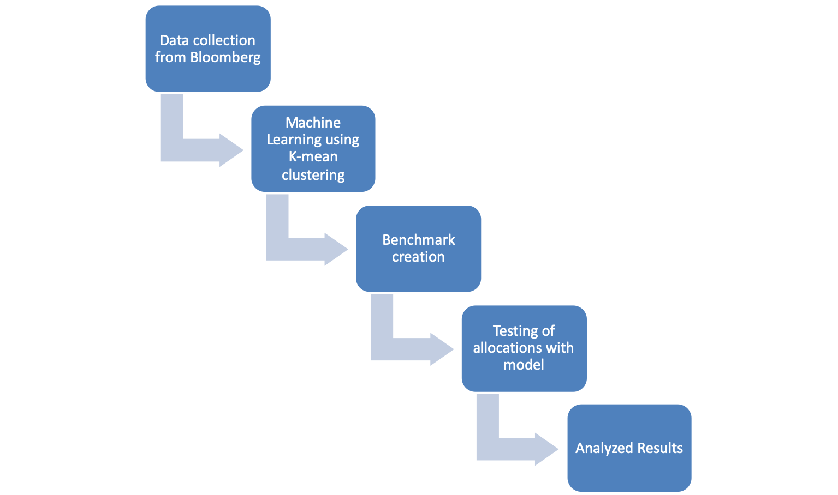
Research Methodology - Flow
6 Assets and Indicators –
DJ,S&P, HS,FTSE,AGG,GOLD
Found two significant indicators
10 years minus 2 year
10 year minus 3 month
Glide Path no model
Recession and non–recession periods
Mean, median, high, low

Slide 8
Research Methodology Baseline
Monthly rolling data, 309 intervals in 10-year increments(120 months).
There are 2,163 simulations where $100k is the initial investment value.
FED recession periods considered: 1990-1991, 2001- 2002 and 2007-2009.
Our model re-allocated on 3 separate occasions to protect the capital from a downturn.
  Used various statistical methods, inner quartile range and clustering algorithms to develop a rule-based model to reallocate assets when a recession is predicted.
      1990-1991
      1999-2001
      2007-2008

Slide 9
Non-Recession Allocation
Glide path allocation (Benchmark Allocation):
High yield allocation:
Assets | Initial | Final
US Equities | 35% | 20%
International Equities | 23% | 13%
Bonds/Gold | 42% | 67%
Assets | Initial | Final
US Equities | 40% | 40%
International Equities | 40% | 40%
Bonds/Gold | 20% | 20%

Slide 10
Recession Allocation
Tested with both glide path & high yield for non-recession allocations
In recession allocations
  Cash
  50% Bonds 50% Gold
  75% Bonds 25% Gold

Slide 11
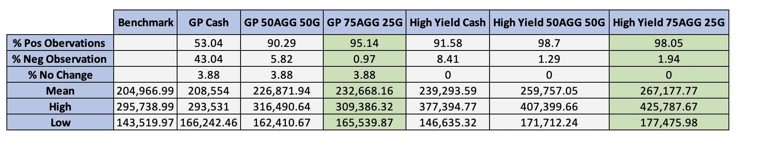
Key Outcomes
The percentage of observations for the 6 test compared to the benchmark:
Trading using our model and rule-based allocations, we beat the benchmark 90% of the time for 5 out of 6 test.
Four of our models had only 2 observations out of 1,236 values 1 which exceeded the benchmark mean, meaning that our models outperformed the benchmark or its mean 99.84% of the time.

Slide 12
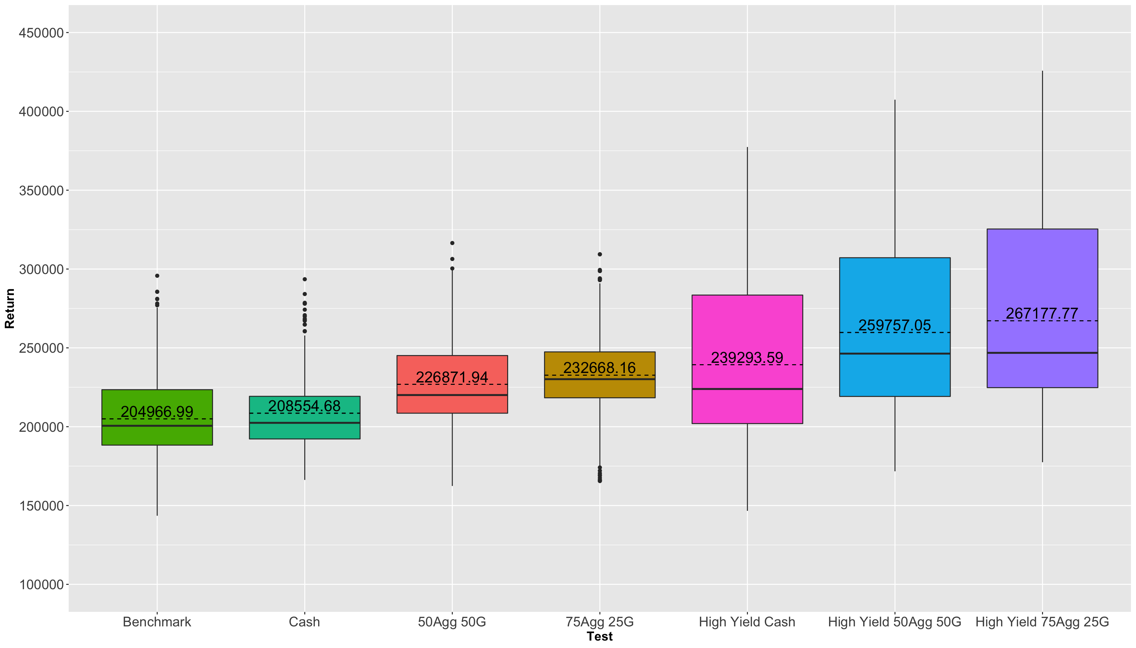
Boxplot:
Benchmark vs. Tests Allocations

Slide 13
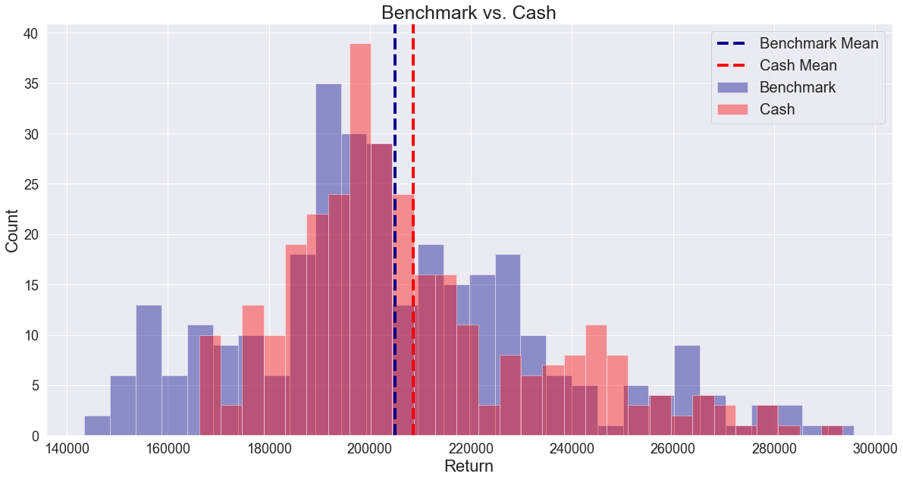
Histogram Plot:
Glide Path Cash

Slide 14
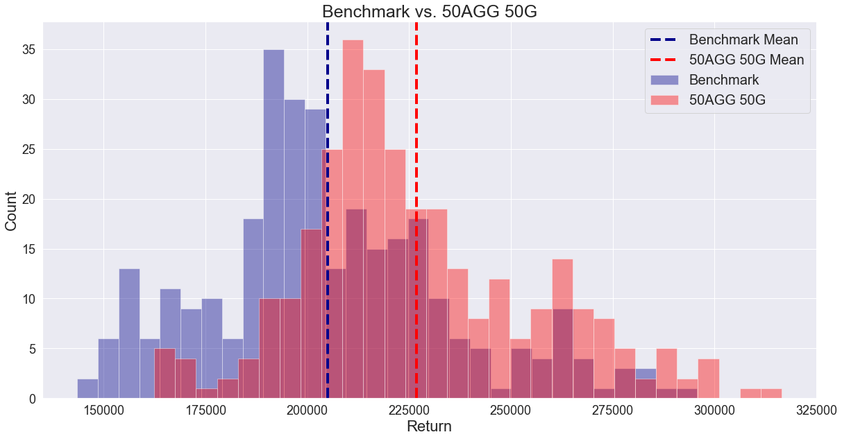
Histogram Plot
Glide Path 50% AGG 50% Gold

Slide 15
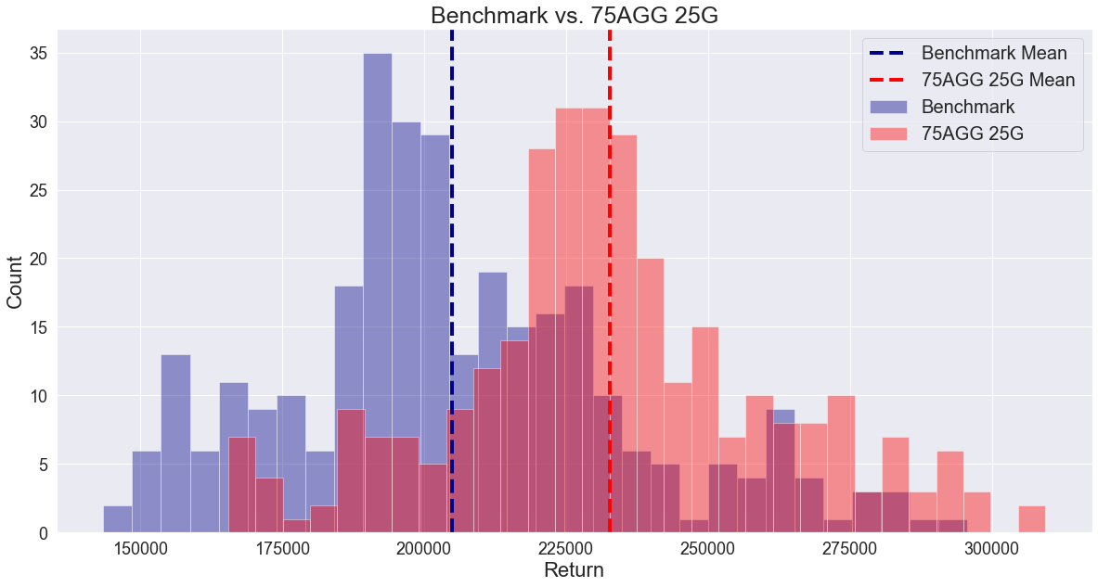
Histogram Plot
Glide Path 75% AGG 25% Gold

Slide 16
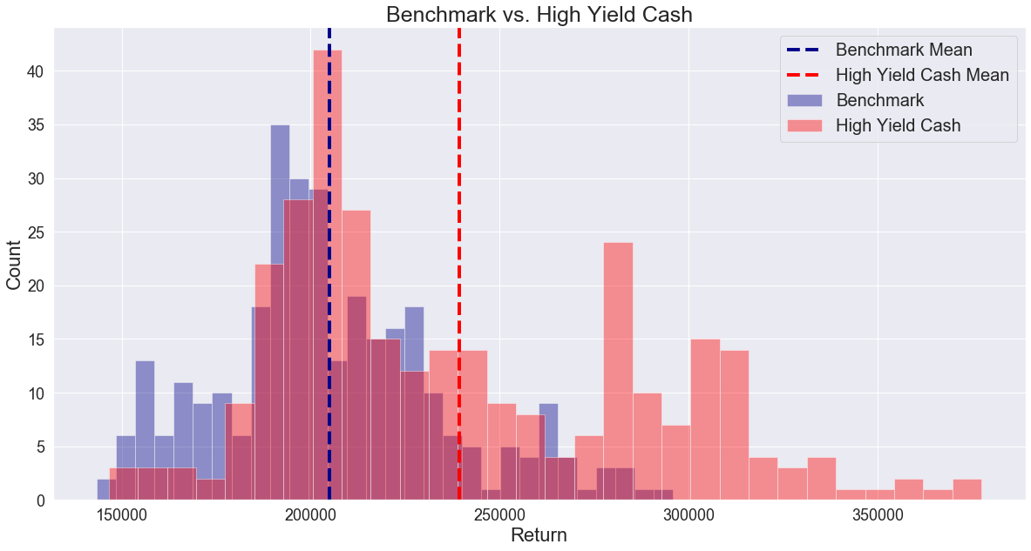
Histogram Plot
High Yield Cash

Slide 17
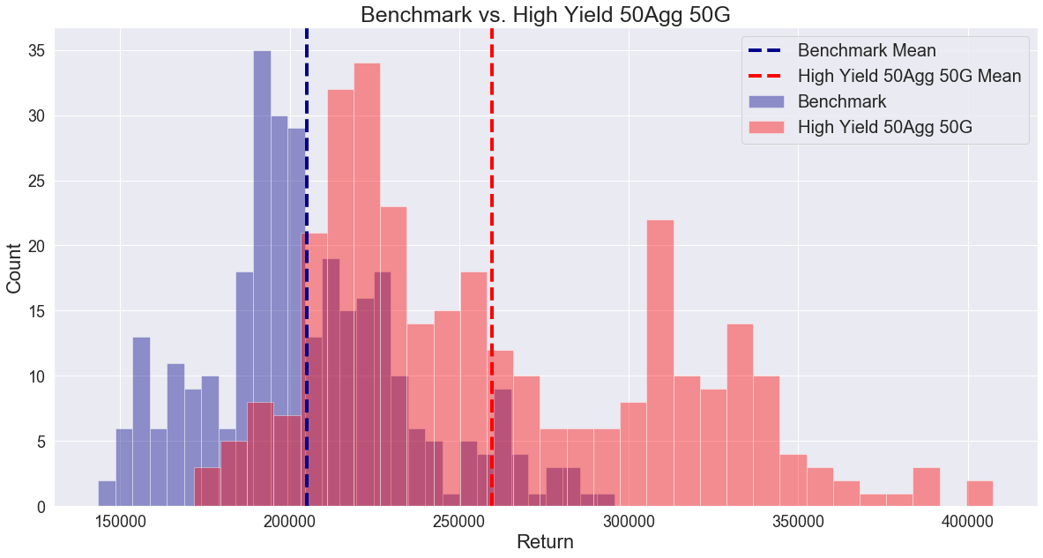
Histogram Plot
High Yield 50% AGG 50% Gold

Slide 18
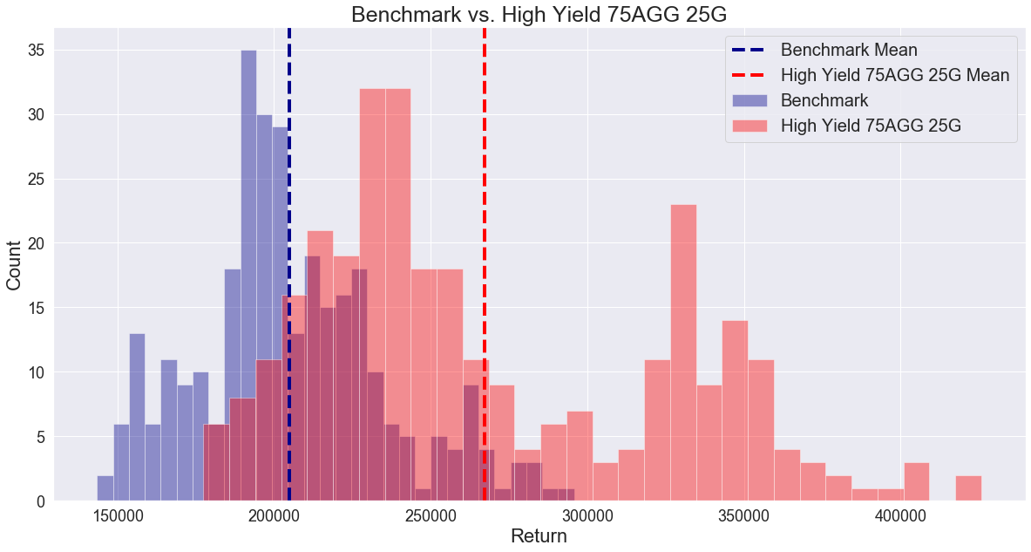
Histogram Plot:
High Yield 75% AGG 25% Gold

Slide 19
Conclusion:
5 out of 6 models outperformed the benchmark 90% of the time
Going to 75% AGG (Bonds) 25% Gold ( Rule-Based and High Yield) in recession periods performed best out of all recession allocation options
  Larger spread of returns
Going to cash (Rule-Based and High Yield) in recession periods was the worst out of all recession allocation options
  Smaller spread of returns

Slide 20
Future Scopes:
More frequent data observations for example week by week or day by day.
Altering the Glide path allocation based on newly perceived risk profile.
Determine new rule-based on new data and parameters.

Slide 21
Thank You

